Slide 1

Computer Graphics
Dr. Lucy J. Gudino
Computer Science & Information Systems Group
Birla Institute of Technology & Science, Pilani, Goa Campus

Slide 2
Introduction
Viewing pipeline:
  graphics processing pipeline is to convert three dimensional descriptions of objects into a two-dimensional image that can be displayed.
  Example :
    use a camera to convert a real-world scene into a two-dimensional print.

Slide 3
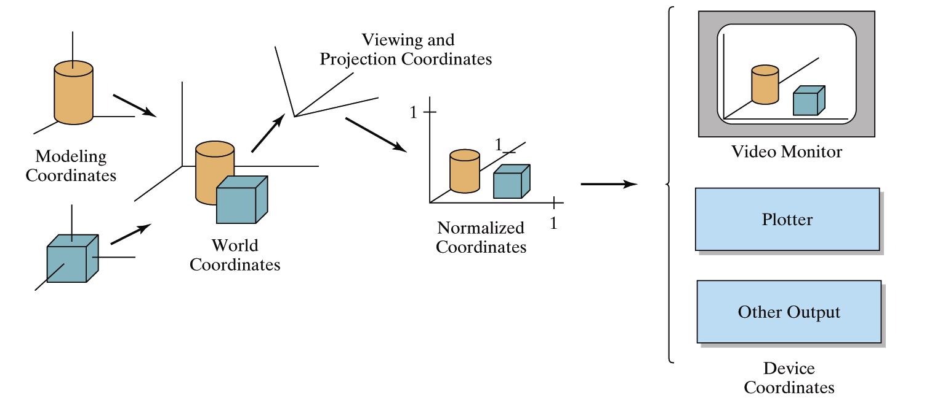
Viewing Pipeline

Slide 4
Contd…
To accomplish the transformation from three dimensions to two dimension , OpenGL defines several coordinate spaces and transformations between those spaces.
Each coordinate space has some properties that make it useful for some part of the rendering process.

Slide 5
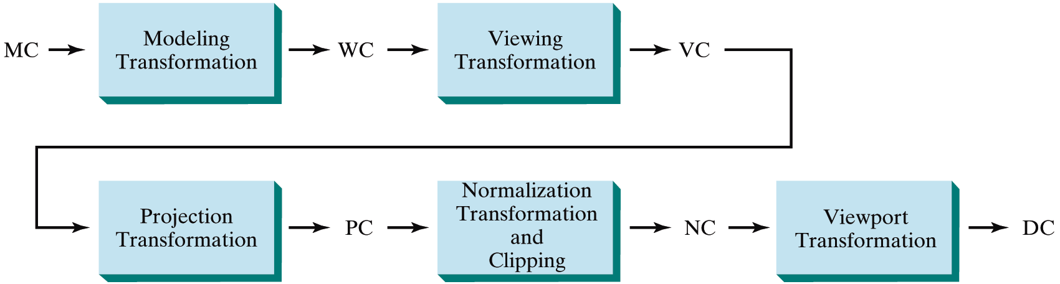
General 3D Viewing Pipeline
Modeling coordinates (MC)
World coordinates (WC)
Viewing coordinates (VC)
Projection coordinates (PC)
Normalized coordinates (NC)
Device coordinates (DC)

Slide 6
Modeling coordinates
Modeling: is the process of defining a numerical representation of an object that is to be rendered
  usually means creating a polygonal representation of an object so that it can be drawn with the polygon primitives built into OpenGL
  a polygonal representation of an object needs to include
    the coordinates of each vertex in each polygon and the connectivity information that defines the polygons.
    the color of each vertex,
    the surface normal at each vertex,
    one or more texture coordinates at each vertex, and so on.

Slide 7
World Coordinates
A scene contains a variety of three-dimensional objects, each of which might be defined in its own unique object space
Need a common coordinate system to represent them.
This common coordinate system is called WORLD SPACE or the WORLD COORDINATE SYSTEM, and it provides a common frame of reference for all objects in the scene.
After world space is defined, all the objects in the scene must be transformed from their own unique object coordinates into world coordinates.
The transformation that takes coordinates from object space to world space is called the MODELING TRANSFORMATION.

Slide 8
Example
If the object's modeling coordinates are in feet but the world coordinate system is defined in terms of inches, the object coordinates must be scaled by a factor of 12 to produce world coordinates.
If the object is defined to be facing forward but in the scene it needs to be facing backwards, a rotation must be applied to the object coordinates.
A translation is also typically required to position the object at its desired location in world coordinates.
All of these individual transformations can be put together into a single matrix, the MODEL TRANSFORMATION MATRIX, that represents the transformation from object coordinates to world coordinates.

Slide 9
Viewing Coordinates
After the scene has been composed, the viewing parameters must be specified.
  the eye or camera position from which the scene will be viewed.
  Viewing parameters also include the focus point (also called the lookat point or the direction in which the camera is pointed) and the up direction (e.g., the camera may be held sideways or upside down).
The viewing parameters collectively define the VIEWING TRANSFORMATION, and they can be combined into a matrix called the VIEWING MATRIX.

Slide 10
Contd…
A coordinate multiplied by this matrix is transformed from world space into EYE SPACE, also called the EYE COORDINATE SYSTEM.
By definition, the origin of this coordinate system is at the viewing (or eye) position.
  Coordinates in this space are called eye coordinates.
  The spatial relationships in the scene remain unchanged, but orienting the coordinate system in this way makes it easy to determine the distance from the viewpoint to various objects in the scene.

Slide 11
Contd..
Note: OpenGL combines modeling matrix and the viewing matrix into a single matrix called the MODELVIEW MATRIX.

Slide 12
Projection Coordinates
After coordinates have been transformed into eye space, the next thing is to define a viewing volume.
This is the region of the three-dimensional scene that is visible in the final image.
The transformation that takes the objects in the viewing volume into CLIP SPACE (also known as the CLIPPING COORDINATE SYSTEM, a coordinate space that is suitable for clipping) is called the PROJECTION TRANSFORMATION.

Slide 13
Normalized coordinates
all the visible graphics primitives are transformed into a cubic region between the point (-1, -1, -1) and the point (1, 1, 1). This is the NORMALIZED DEVICE COORDINATE SPACE, which is an intermediate space that allows the viewing area to be properly mapped onto a viewport of arbitrary size and depth.

Slide 14
Device coordinates
The VIEWPORT TRANSFORMATION specifies the mapping from normalized device coordinates into window coordinates.

Slide 15
Polygon details
A polygon has two sides - front and back and are rendered differently depending on which side is facing the viewer.
By default, both front and back faces are drawn in the same way.
To change this, or to draw only outlines or vertices, use glPolygonMode().

Slide 16
Contd…
void glPolygonMode(GLenum face, GLenum mode);
Face:
  GL_FRONT_AND_BACK
  GL_FRONT
  GL_BACK;
Mode:
  GL_POINT,
  GL_LINE,
  GL_FILL

Slide 17
3-D Objects

Slide 18
Glut models
glutSolidSphere()
glutSolidCube()
glutSolidCone()
glutSolidTorus()
glutSolidDodecahedron()
glutSolidOctahedron()
glutSolidTetrahedron()
glutSolidIcosahedron()
glutSolidTeapot()
glutWireSphere()
glutWireCube()
glutWireCone()
GlutWireTorus()
glutWireDodecahedron()
GlutWireOctahedron()
glutWireTetrahedron()
glutWireIcosahedron()
glutWireTeapot()

Slide 19
Drawing 3D objects
glutWireSphere() or glutSolidSphere()
render a solid or wireframe sphere respectively.
    void glutSolidSphere(GLdouble radius, GLint slices, GLint stacks);
    Void glutWireSphere(GLdouble radius, GLint slices, GLint stacks);
  radius: The radius of the sphere.
  slices: The number of subdivisions around the Z axis (similar to lines of longitude).
  stacks: The number of subdivisions along the Z axis (similar to lines of latitude).

Slide 20
Contd…
glutReshapeFunc ();
  glutReshapeFunc sets the reshape callback for the current window.
  The reshape callback is triggered when a window is reshaped.
  A reshape callback is also triggered immediately before a window's first display callback after a window is created or whenever an overlay for the window is established. The width and height parameters of the callback specify the new window size in pixels. Before the callback, the current window is set to the window that has been reshaped.

Slide 21
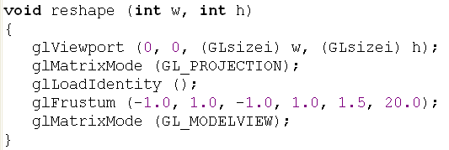
Contd…

Slide 22
Contd…
void glViewport ( GLint x , GLint y , GLsizei width , GLsizei height );
x , y Specify the lower left corner of the viewport rectangle, in pixels. The initial value is (0,0) .
width , height specify the width and height of the viewport. When a GL context is first attached to a window, width and height are set to the dimensions of that window
Notes:
An affine transformation is any transformation that preserves collinearity (i.e., all points lying on a line initially still lie on a line after transformation) and ratios of distances (e.g., the midpoint of a line segment remains the midpoint after transformation).

Slide 23
glLoadIdentity ();
void glLoadIdentity( void);
glLoadIdentity replaces the current matrix with the identity matrix. It is semantically equivalent to calling glLoadMatrix with the identity matrix
1000010000100001

Slide 24
glLoadMatrix
replace the current matrix with the specified matrix
void glLoadMatrixd( const GLdouble * m);
void glLoadMatrixf( const GLfloat * m);
m Specifies a pointer to 16 consecutive values, which are used as the elements of a 4×4 column-major matrix.

Slide 25
glFrustum
glFrustum — multiply the current matrix by a perspective matrix
glFrustum describes a perspective matrix that produces a perspective projection. The current matrix is multiplied by this matrix and the result replaces the current matrix
void glFrustum( GLdouble left, GLdouble right, GLdouble bottom, GLdouble top, GLdouble nearVal, GLdouble farVal);

Slide 26
Contd…
left, right Specify the coordinates for the left and right vertical clipping planes.
bottom, top Specify the coordinates for the bottom and top horizontal clipping planes.
nearVal, farVal Specify the distances to the near and far depth clipping planes. Both distances must be positive.

Slide 27
glMatrixMode
glMatrixMode sets the current matrix mode. mode can assume one of four values:
  GL_MODELVIEW Applies subsequent matrix operations to the modelview matrix stack.
  GL_PROJECTION Applies subsequent matrix operations to the projection matrix stack.
  GL_TEXTURE Applies subsequent matrix operations to the texture matrix stack.
  GL_COLOR Applies subsequent matrix operations to the color matrix stack.

Slide 28
gluLookAt
gluLookAt — define a viewing transformation
void gluLookAt( GLdouble eyeX, GLdouble eyeY, GLdouble eyeZ, GLdouble centerX, GLdouble centerY, GLdouble centerZ, GLdouble upX, GLdouble upY, GLdouble upZ);
Notes:
Look from the camera
Look at where
Look up

Slide 29
Contd…
gluLookAt creates a viewing matrix derived from an eye point, a reference point indicating the center of the scene
  eyeX, eyeY, eyeZ : Specifies the position of the eye point.
  centerX, centerY, centerZ :Specifies the position of the reference point.
  upX, upY, upZ :Specifies the direction of the up vector.

Slide 30
glScalef
glScale — multiply the current matrix by a general scaling matrix
void glScaled( GLdouble x, GLdouble y, GLdouble z);
void glScalef( GLfloat x, GLfloat y, GLfloat z);

Slide 31
Drawing 3D objects …
glutSolidCube, glutWireCube
render a solid or wireframe cube respectively
void glutSolidCube(GLdouble size);
void glutWireCube(GLdouble size);

Slide 32
Drawing 3D objects …
glutSolidCone, glutWireCone
render a solid or wireframe cone respectively.
  void glutSolidCone(GLdouble base, GLdouble height, GLint slices, GLint stacks);
  void glutWireCone(GLdouble base, GLdouble height, GLint slices, GLint stacks);
  base: The radius of the base of the cone.
  height: The height of the cone.
  slices: The number of subdivisions around the Z axis.
  Stacks: The number of subdivisions along the Z axis.

